Slide 1
Unit-5
Financial services

Slide 2
Financial services
Financial services: Introduction, Meaning and function of Financial Services,
Fee Based and Fund Based Services,
Meaning and Concept of Merchant Banking,
Venture Capital Financing,
Investment and Mutual Fund,
Credit Rating and
Stock Broking and
Leasing.
Unit Objectives:
To understand about Financial Services

Slide 3
FINANCIAL SERVICES
Introduction :
The Indian financial services industry has undergone a metamorphosis since1990. Before its emergence the commercial banks and other financial institutions dominated the field and they met the financial needs of the Indian industry. It was only after the economic liberalization that the financial service sector gained some prominence. Now this sector has developed into an industry. In fact, one of the world’s largest industries today is the financial services industry. Financial service is an essential segment of financial system. Financial services are the foundation of a modern economy. The financial service sector is indispensable for the prosperity of a nation.
Meaning of Financial Services In general, all types of activities which are of financial nature may be regarded as financial services. In a broad sense, the term financial services means mobilization and allocation of savings. Thus, it includes all activities involved in the transformation of savings into investment.
Financial services refer to services provided by the finance industry. The finance industry consists of a broad range of organizations that deal with the management of money. These organizations include banks, credit card companies, insurance companies, consumer finance companies, stock brokers, investment funds and some government sponsored enterprises.
Financial services may be defined as the products and services offered by financial institutions for the facilitation of various financial transactions and other related activities.
Financial services can also be called financial intermediation. Financial intermediation is a process by which funds are mobilized from a large number of savers and make them available to all those who are in need of it and particularly to corporate customers. There are various institutions which render financial services. Some of the institutions are banks, investment companies, accounting firms, financial institutions, merchant banks, leasing companies, venture capital companies, factoring companies, mutual funds etc. These institutions provide variety of services to corporate enterprises. Such services are called financial services. Thus, services rendered by financial service organizations to industrial enterprises and to ultimate consumer markets are called financial services. These are the services and facilities required for the smooth operation of the financial markets. In short, services provided by financial intermediaries are called financial services

Slide 4
Functions of financial services
Facilitating transactions (exchange of goods and services) in the economy.
Mobilizing savings (for which the outlets would otherwise be much more limited).
Allocating capital funds (notably to finance productive investment).
Monitoring managers (so that the funds allocated will be spent as envisaged)
Transforming risk (reducing it through aggregation and enabling it to be carried by those more willing to bear it).
Characteristics or Nature of Financial Services
From the following characteristics of financial services, we can understand their nature:
1. Intangibility: Financial services are intangible. Therefore, they cannot be standardized or reproduced in the same form. The institutions supplying the financial services should have a better image and confidence of the customers. Otherwise, they may not succeed. They have to focus on quality and innovation of their services. Then only they can build credibility and gain the trust of the customers.
2. Inseparability: Both production and supply of financial services have to be performed simultaneously. Hence, there should be perfect understanding between the financial service institutions and its customers.
3. Perishability: Like other services, financial services also require a match between demand and supply. Services cannot be stored. They have to be supplied when customers need them.
4. Variability: In order to cater a variety of financial and related needs of different customers in different areas, financial service organizations have to offer a wide range of products and services. This means the financial services have to be tailor-made to the requirements of customers. The service institutions differentiate their services to develop their individual identity.
5. Dominance of human element: financial services are labor intensive. quality financial products.
6. Information based: Financial service industry is an information based industry. It involves creation, dissemination and use of information. Information is an essential component in the production of financial services.

Slide 5
Importance of Financial Services
The successful functioning of any financial system depends upon the range of financial services offered by financial service organizations. The importance of financial services may be understood from the following points:
Economic growth: The financial service industry mobilizes the savings of the people, and channels them into productive investments by providing various services to people in general and corporate enterprises in particular. In short, the economic growth of any country depends upon these savings and investments.
Promotion of savings: The financial service industry mobilizes the savings of the people by providing transformation services. It provides liability, asset and size transformation service by providing huge loan from small deposits collected from a large number of people. In this way financial service industry promotes savings.
Capital formation: Financial service industry facilitates capital formation by rendering various capital market intermediary services. Capital formation is the very basis for economic growth.
Creation of employment opportunities: The financial service industry creates and provides employment opportunities to millions of people all over the world.
Contribution to GNP: Recently the contribution of financial services to GNP has been increasing year after year in almost countries.
Provision of liquidity: The financial service industry promotes liquidity in the financial system by allocating and reallocating savings and investment into various avenues of economic activity. It facilitates easy conversion of financial assets into liquid cash.

Slide 6
Fund based and Non-Fund based (Fee based):
Financial services cover a wide range of activates. They can be broadly classified into (i) Traditional activities and (ii) Modern activities.
Traditional activities include (i) Fund based activities and (ii) Non-Fund based (Fee based) activities.
The fund based activities which the financial intermediaries render are
Dealing in shares, bonds, debenture of new issues
Dealing in secondary market activities.
Dealing in money market instruments
Involving in hire-purchase, leasing, venture capital etc.
Dealing in foreign exchange market activities.
Non-fund based activities are fee based activities. These are not connected with provision of finance. The financial intermediaries are expected to render services are
Manage Capital issues
Arranging placement of capital and debt instruments with investment with investment institutions
Arrangements of project finance and working capital funds from financial institutions
Assisting in the process getting all clearances from the government departments.

Slide 7


Slide 8
Merchant Banking in India
The industrial boom in India has led to major growth in the need for merchant bankers. Merchant banking is an amalgam of banking and consultancy services. Although, the word merchant banking has a different meaning in different countries. In the U.S. merchant, bankers are called “Investment Banks,” in the U.K., they are called “accepting and issuing houses.”
In India, a merchant banker is defined as “an individual who is who is involved in the business of issue management either by making arrangements regarding buying, selling or subscribing to the securities as a manager, advisor, consultant in relation to such an issue management.”
Merchant banks render numerous financial services, advice, consultation, management, counseling, and solutions to big corporate houses. They are pretty different from normal commercial banks in several ways.
For example, commercial banks generally accept deposits and give loans, but merchant banks only offer consultation and management for a certain charge. They only accept deposits and offer loans only to a few clients and not to the general public

Slide 9
History of Merchant Banking
Merchant banks were established back in the 17 and 18 centuries in France and Italy by the Italian grain merchants. Initially, in merchant banking, a few merchant bankers were included who were intermediates in financing other transactions or their own.
After a couple of years, the practice of merchant banking evolved in the modern era from London. Merchants began to finance foreign trade by acceptance of the bill. With time they started using other services such as underwriting the issues, loan syndication, portfolio management, etc.
Merchant banking in India began in 1967 by National Grindlays; later, Citi Bank started it in 1970. In the year 1972, SBI became the first commercial bank to set up a distinct division for merchant banking. Then it was followed by ICICI in 1973, and then various banks started these services such as PNB, Bank of India, UCO Bank, etc.
It was in 1973 when FERA came into existence that helped increase merchant banking activities in India. After that, various banks such as IDBI and IFCI entered the market.

Slide 10
Features of Merchant Banking
Here are some of the must-know characteristics of merchant banking in India-
High ratio of decision-makers as a percentage of the complete staff
Loose organizational structure
Fast decision mechanism.
Refined services on both national and international levels.
Huge amount of information.
Profound contact with the environment.
Priority on fee and commission returns.
Innovative instead of monotonous operations
Elevated liquidity ratio
Consolidation of short and medium-term engagements
Low ratio of profit allocation

Slide 11
Reasons for growth of Merchant Banking
There are a few reasons that accelerated the growth of these banks in India. Some of the reasons are:
Globalization: After the 1991 reforms, the Indian economy saw a drastic change as it opened gates for foreign companies. It helped in getting funds from abroad; thus, it led to the growth of merchant banks.
2. Elevated Competition: Because of the globalization of the economy, the market scenarios became lucrative, and business options became favorable for various individuals. This pivoted the Indian corporate sector, and a huge expansion was seen in this sector. This motivated the Merchant Bankers to play an important role by offering specialized services to corporate.
3. Switch in consumer trends: There was a huge transformation in the industrial and corporate sectors because of the foreign players in the market.
The major benefit was that the Indian massed started getting better quality products as the Indian companies also started working on quality to match the foreign products. In such prevailing environments, financial products and instruments became more prominent.
4. Government Reforms: Government intervention was reduced, and privatization was increased. It also raised the limits of investment and lessened direct interventions that led to an increase in the proposition of foreign players.

Slide 12
Services of Merchant Banking
Portfolio Management: It refers to decreasing the risk and maximizing the profits. This expression is usually used in connection to shares and debentures only. Merchant bankers offer these services to their customers and guide the investors in selecting the right securities as per their needs. Thus, merchant bankers ensure that they are updated with the complete market information.
2. Corporate Counseling: This is the basic service that merchant banks offer as all industrial units, whether new or existing, require this service. There is a wide range of services that come under corporate counseling, such as project counseling, capital restructuring, project management, working capital management, public issue management, loan syndications, fixed deposit, and lease financing.
3. Management of Capital Issues: This service comprises selling securities, equity shares, debentures, preference shares, etc., to the investors. The role of the merchant banker here is to make an action plan and budget for expenses for coordinating with underwriters, the expense for the issues, choosing the advertising agency for pre and post-issue. For doing this, they have to be in touch with agencies that are involved in public issues.
4. Underwriting services: This is one of the most important services given by merchant banks as in this, the bank gives a guarantee that states that if the agreement is below the specified level, then the bank would have to contribute to the stated expense.
5. Loan Syndication: This service is pretty unusual from what the other banks offer. Here the merchant banks arrange a loan for a borrower who can be a big company, a government department, or a local authority. But, there are a lot of measures that a merchant banker has to take before a loan.

Slide 13
Other services that merchant banks offer are:
Project Counseling
Issue Management
Foreign Currency Financing
Advisory Services to Mergers and Takeovers
Broking Corporate Advisory Services Leasing
Consultancy to Sick Industrial Units
Providing Venture Capital Financing
Act as Debenture Trustee
Types of the organization that offer Merchant Banking services:
Here are the organizations that provide Merchant banking services in India:
Commercial Banks and their sub-banks
Foreign Banks comprise Citi Bank, National Grindlays bank, Hong Kong Bank, etc.
State Level Financial Institutions are State Industrial Development Corporations (SIDC’s) and State Financial Corporations.
All India Financial Institutions and Development Banks like ICICI, IFCI, IDBI, etc.
Private Financial Consultancy Firms and Brokers, like J.M. Financial and Investment Services Ltd.; Fnam Financial Consultants, Ceat Financial Services, DSP Financial Consultants, Kotak Mahindra, etc.
Professional Merchant Banking Houses.
Technical Consultancy Organisations

Slide 14
Functions of Merchant Bankers
There are a lot of functions that merchant banks do; let’s have a look at some of them:
Help raise funds: The highlighting part about merchant banks is that they assist their clients in raising funds from the market by issuing shares, debentures, and bank loans. They help to raise funds from both domestic and international markets.
Revival of sick units: They support the companies in rebuilding the disabled manufacturing units. They meet a lot of long-term financial institutions and the Industrial and Financial Restoration Council for backing them.
Handling government permission: Almost all the business needs the consent of government for commencing a fresh project. In fact, there are a lot of industries that need permission for expansion and modernization; hence merchant banks handle government permissions for their clients.
Advice on various issues: Merchant Banking in India is relatively different from other countries as here they also offer advice to their clients on modernization and expansion of business.
Brokers in the stock exchange: They also serve as a broker in the stock exchange for their clients, plus they also buy and sell shares on account of them.
Promotional Activities: They also play the role of industrial business promoters as well. They enable the developers to build innovations, make feasibility studies, define ventures, and receive public bodies and opportunities permits.
Services to private sector units: They provide services to public sector units by offering numerous services like help in getting long term capital, foreign collaboration, marketing of securities, and also manage their long term finance

Slide 15
8. Management of interest and dividend: They also guide their clients in managing both dividends on shares and interest on debentures. Merchant bank proffers them directions on the rate of dividend and timing as well.
9. Money Market operation: They also trade with short-term money market instruments such as government bonds, commercial paper issues by big corporate enterprises, treasury bills issued by RBI, etc.
Managing Public issue of companies
Assistance to small companies
Leasing services
Managing public issue

Slide 16
Merchant Bankers in India
There are more than 130 merchant bankers who are registered with SEBI. Here is the list of some significant ones:
Public Sector Merchant Bankers
State Bank of Bikaner and Jaipur
Karur Vysya Bank
SBI Capital markets Ltd.
IFCI Financial Services Ltd.
Punjab National Bank
Bank of Maharashtra
Private Sector Merchant Bankers
Yes, Bank Ltd.
ICICI Securities Ltd.
Kotak Mahindra Capital Company Ltd.
Axis Bank Ltd.
Tata Capital Markets Ltd.
Reliance Securities Ltd.
Bajaj Capital Ltd.
ICICI Bank Ltd.

Slide 17
Foreign Players in Merchant Banking
FedEx Securities Ltd.
Goldman Sachs (India) Securities Pvt. Ltd.
DSP Merrill Lynch Ltd.
Deutsche Equities India Private Limited
Morgan Stanley India Company Pvt. Ltd.
Citigroup Global Markets India Pvt. Ltd.
Barclays Securities (India) Pvt. Ltd.
Barclays Bank Plc
Deutsche Ban
Classification of Merchant Bankers
Merchant bankers have been divided into four categories for registration-
Category 1: The role of merchant bankers in this category is to act as a consultant, advisor, issue manager, portfolio manager, and underwriter.
Category 2: Merchant Bankers in this category act as a consultant, advisor, portfolio manager, and underwriter. They cannot be an issue manager of their own but can act as co-manager.
Category 3: In this category, merchant bankers cannot do activities related to portfolio management, plus they can neither take issue management of their own nor act as a co-manager. They can act as a consultant, advisor, and underwriter.
Category 4: If the merchant banker lies in this category, then they can just act as a consultant or advisor to an issue of capital.

Slide 18
Venture Capital:-
The term venture capital comprises of two words, namely, ‘venture’ and ‘capital’. The term ‘venture’ literally means a ‘course’ or ‘proceeding’, the outcome of which is uncertain (i.e., involving risk). The term capital refers to the resources to start the enterprise. Thus venture capital refers to capital investment in a new and risky business enterprise. Money is invested in such enterprises because these have high growth potential.
Characteristics of Venture Capital: The important characteristics of venture capital finance are outlined as bellow:
1. It is basically equity finance.
2. It is a long term investment in growth-oriented small or medium firms.
3. Investment is made only in high risk projects with the objective of earning a high rate of return.
4. In addition to providing capital, venture capital funds take an active interest in the management of the assisted firm. It is rightly said that, “venture capital combines the qualities of banker, stock market investor and entrepreneur in one”.
5. The venture capital funds have a continuous involvement in business after making the investment.
6. Once the venture has reached the full potential, the venture capitalist sells his holdings at a high premium. Thus his main objective of investment is not to earn profit but capital gain.

Slide 19
Types of Venture Capitalists Generally, there are three types of venture capital funds. They are as follows:
Venture capital funds set up by angel investors (angels): They are individuals who invest their personal capital in start up companies. They are about 50 years old. They have high income and wealth. They are well educated. They have succeeded as entrepreneurs. They are interested in the start up process.
Venture capital subsidiaries of Corporations: These are established by major corporations, commercial banks, holding companies and other financial institutions.
Private capital firms/funds: The primary source of venture capital is a venture capital firm. It takes high risks by investing in an early stage company with high growth potential.

Slide 20
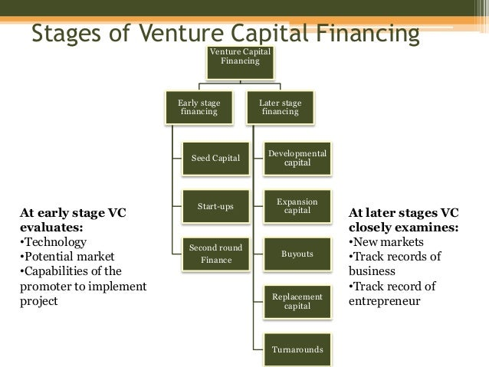

Slide 21
Stages of Venture Capital Financing Venture capital takes different forms at different stages of a project. The various stages in the venture capital financing are as follows:
1. Early stage financing: This stage has three levels of financing. These three levels are:
Seed financing: This is the finance provided at the project development stage. A small amount of capital is provided to the entrepreneurs for concept testing or translating an idea into business.
Start up finance/first stage financing: This is the stage of initiating commercial production and marketing. At this stage, the venture capitalist provides capital to manufacture a product.
Second stage financing: This is the stage where product has already been launched in the market but has not earned enough profits to attract new investors. Additional funds are needed at this stage to meet the growing needs of business. Venture capital firms provide larger funds at this stage.
2. Later stage financing: This stage of financing is required for expansion of an enterprise that is already profitable but is in need of further financial support. This stage has the following levels:
Third stage/development financing: This refers to the financing of an enterprise which has overcome the highly risky stage and has recorded profits but cannot go for public issue. Hence it requires financial support. Funds are required for further expansion.
Turnarounds: This refers to finance to enable a company to resolve its financial difficulties. Venture capital is provided to a company at a time of severe financial problem for the purpose of turning the company around.

Slide 22
(c) Fourth stage financing/bridge financing: This stage is the last stage of the venture capital financing process. The main goal of this stage is to achieve an exit vehicle for the investors and for the venture to go public. At this stage the venture achieves a certain amount of market share.
(d) Buy-outs: This refers to the purchase of a company or the controlling interest of a company’s share. Buy-out financing involves investments that might assist management or an outside party to acquire control of a company. This results in the creation of a separate business by separating it from their existing owners.
Advantages of Venture Capital :Venture capital has a number of advantages over other forms of finance. Some of them are:
1. It is long term equity finance. Hence, it provides a solid capital base for future growth.
2. The venture capitalist is a business partner. He shares the risks and returns.
3. The venture capitalist is able to provide strategic operational and financial advice to the company.
4. The venture capitalist has a network of contacts that can add value to the company. He can help the company in recruiting key personnel, providing contracts in international markets etc.
5. Venture capital fund helps in the industrialization of the country.
6. It helps in the technological development of the country.
7. It generates employment.
8. It helps in developing entrepreneurial skills.
9. It promotes entrepreneurship and entrepreneurism in the country.

Slide 23
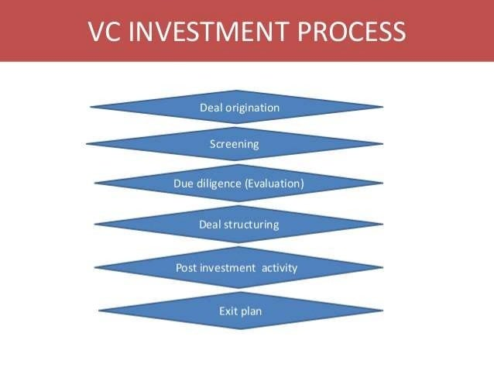

Slide 24
Investment:
An investment is essentially an asset that is created with the intention of allowing money to grow. The wealth created can be used for a variety of objectives such as meeting shortages in income, saving up for retirement, or fulfilling certain specific obligations such as repayment of loans, payment of tuition fees, or purchase of other assets.
Understanding the investment is crucial as sometimes, it can be difficult to choose the right instruments to fulfill our financial goals. Knowing the investment meaning in our particular financial situation will allow us to make the right choices.
Investment may generate income for individual in two ways. One, if we invest in a saleable asset, we may earn income by way of profit. Second, if Investment is made in a return generating plan, then we will earn an income via accumulation of gains. In this sense, ‘what is investment’ can be understood by saying that investments are all about putting individual savings into assets or objects that become worth more than their initial worth or those that will help produce an income with time.
Financially speaking, an investment definition is an asset that is obtained with the intention of allowing it to appreciate in value over time. Generally, investments fall in any one of three basic categories, as explained below.
Types of Investments
The question ‘what is investment’ is mostly followed by understanding investment objectives and identifying where to invest. Keeping aside investments in real estate and assets like jewellery and all, when it comes to different instruments, another aspect of understanding ‘what is investment meaning’ is to know about different types of investments. The first refers to equity investments, and the second category includes debt instruments. If individuals investment objectives match, equity investments can offer greater returns and carry relatively higher risk. While debt instruments are less risky, but offer relatively low returns.

Slide 25
Following are different types of investments in India:
1. Stocks
This includes shares of ownership of any company and helps earn dividends in return.
2. Bonds
What is investment meaning in terms of bonds? It means lending money to an institution or government, for which individual receive fixed interest at regular intervals and also the face value upon maturity.
3. Mutual Funds
In this, funds are collected from different investors and put in a company’s bonds or shares, which are managed by fund managers.
4. ULIP
ULIPs or Unit Linked Insurance Plans are a type of investment that provides both investment and life insurance benefits. A portion of the money invested into ULIPs is allocated for investment, meaning in this plan a part of premium is invested in different funds and helps customer earn market linked returns. It also
offers tax-saving benefits of up to Rs. 1.5 lakhs under Section 80C.
5. Public Provident Fund (PPF)
Understanding investment meaning of PPF is simple. It is a government offered saving scheme that invests individuals funds for a specific period and helps they can earn returns on the same. It provides an 8%
interest rate starting 1st October 2018.

Slide 26
When talking about equity investments, individual may wonder what is equity share?
Here’s what investor need to know to understand what is equity share:
Any corporation can use equity shares as a long-term financing source. These are non-redeemable shares that are issued to the general public. Shareholders have the right to vote, share profits, and claim a company's assets.
How Should Individual Invest?
The next thing is to understand how to invest. Here are a few vital points individual must keep in mind before decide to invest.
1. Analyze Financial Needs
Firstly, analyze financial situation concerning risk tolerance, investment objectives and other factors like family size, number of earning members and life goals. People may even take help from a financial professional. It will help them clarify any doubts about ‘what is investment meaning for them?’ and identify the suitable options.
2. Investment Diversification
Build a diversified financial portfolio according to investment objectives by putting funds in different instruments for maintaining the right balance between risk and returns.
Also, when thinking about ‘what is investment meaning’ and ‘where to invest,’ consider giving priority to those instruments that offer security to loved ones. It may include life insurance policies like term plan, ULIP (Unit Linked Insurance Plan) and other such instruments.

Slide 27
3. Time Period
People should also know that it is difficult to answer what is investment meaning for a particular individual without considering the time period. That is why, while considering what is investment, know what time they have before turning their investments into cash. This is a crucial element that determines their investment objectives. Depending on their requirements, they may choose short-term or long-term funds.
4. Periodical Reassessment
Since funds are influenced by market forces, it is imperative that customer closely monitor them periodically. Customers may also consider readjustment if their portfolio is not generating good returns.
Depending on costumers investment and savings objectives, they can choose from a variety of investment plans offered by Max Life including Guaranteed Income Plan, Smart Wealth Plan, Savings Advantage Plan and more.
Objectives of Investment:
Before decide to invest customer earnings in any one of the many investment plans available in India, it’s essential to understand the reasons behind it and the investment meaning. While the individual objectives of investment may vary from one investor to another, the overall goals of investing money may be any one of the following reasons..
1. To Keep Money Safe
Capital preservation is one of the primary objectives of investment for people. Some investments help keep hard-earned money safe from being eroded with time. By parking individual’s funds in these instruments or schemes, they can ensure that they do not outlive their savings. Fixed deposits, government bonds, and even an ordinary savings account can help keep individuals money safe. Although the return on investment may be lower here, the objective of capital preservation is easily met.

Slide 28
2. To Help Money Grow
Another one of the common objectives of investing money is to ensure that it grows into a sizable corpus over time. Capital appreciation is generally a long-term goal that helps people secure their financial future. To make the money individuals earn grow into wealth, they need to consider investment objectives and options that offer a significant return on the initial amount invested. Some of the best investments to achieve growth include real estate, mutual funds, commodities, and equity. The risk associated with these options may be high, but the return is also generally significant.
3. To Earn a Steady Stream of Income
Investments can also help individuals earn a steady source of secondary (or primary) income. Examples of such investments include fixed deposits that pay out regular interest or stocks of companies that pay investors dividends consistently. Income-generating investments can help pay for everyday expenses after the retirement. Alternatively, they can also act as excellent sources of supplementary income during working years by providing with additional money to meet outlays like college expenses or EMIs.
4. To Minimize the Burden of Tax
Aside from capital growth or preservation, investors also have other compelling objectives for investment. This motivation comes in the form of tax benefits offered by the Income Tax Act, 1961. Investing in options such as Unit Linked Insurance Plans (ULIPs), Public Provident Fund (PPF), and Equity Linked Savings Schemes (ELSS) can be deducted from Individuals total income. This has the effect of reducing their taxable income, thereby bringing down their tax liability.

Slide 29
5. To Save up for Retirement
Saving up for retirement is a necessity. It is essential to have a retirement fund can fall back on in golden years, because people may not be able to continue working forever. By investing the money earn during working years in the right investment options, can allow y funds to grow enough to sustain after retirement.
6. To Meet Financial Goals
Investing can also help achieve short-term and long-term financial goals without too much stress or trouble. Some investment options, for instance, come with short lock-in periods and high liquidity. These investments are ideal instruments to park individuals funds in if their wish to save up for short-term targets like funding home improvements or creating an emergency fund. Other investment options that come with a longer lock-in period are perfect for saving up for long-term goals.

Slide 30
Mutual Funds:-
Small investors generally do not have adequate time, knowledge, experience and resources for directly entering the capital market. Hence they depend on an intermediary. This financial intermediary is called mutual fund.
Mutual funds are corporations that accept money from savers and then use these funds to buy stocks, long term funds or short term debt instruments issued by firms or governments. These are financial intermediaries that collect the savings of investors and invest them in a large and well diversified portfolio of securities such as money market instruments, corporate and government bonds and equity shares of joint stock companies. They invest the funds collected from investors in a wide variety of securities i.e. through diversification. In this way it reduces risk.
Mutual fund works on the principle of “small drops of water make a big ocean”. It is a form of collective investment. To get the surplus funds from investors, it adopts a simple technique. Each fund is divided into a small share called ‘units’ of equal value. Each investor is allocated units in promotion to the size of his investment.
SEBI (mutual funds) Regulations, 1993 defines a mutual fund as ‘a fund established in the form of a trust by a sponsor, to raise monies by the trustees through the sale of units to the public, under one or more schemes, for investing in securities in accordance with these regulations.
In short, a mutual fund collects the savings from small investors, invests them in government and other corporate securities and earns income through interest and dividends, besides capital gains.

Slide 31


Slide 32
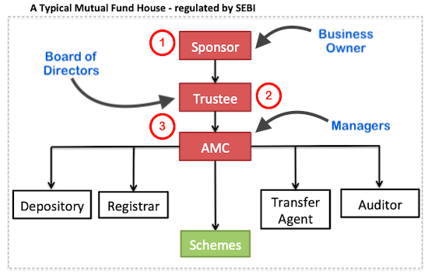

Slide 33
Features of Mutual Funds :
Mutual fund possesses the following features:
Mutual fund mobilizes funds from small as well as large investors by selling units.
Mutual fund provides an ideal opportunity to small investors an ideal avenue for investment.
Mutual fund enables the investors to enjoy the benefit of professional and expert management of their funds.
Mutual fund invests the savings collected in a wide portfolio of securities in order to maximize return and minimize risk for the benefit of investors.
Mutual fund provides switching facilities to investors who can switch from one scheme to another.
Various schemes offered by mutual funds provide tax benefits to the investors.
In India mutual funds are regulated by agencies like SEBI.
The cost of purchase and sale of mutual fund units is low.
Mutual funds contribute to the economic development of a country.
Objectives of Mutual Funds
To mobilize savings of people.
To offer a convenient way for the small investors to enter the capital and the money market
To tap domestic savings and channelize them for profitable investment.
To enable the investors to share the prosperity of the capital market.
To act as agents for growth and stability of the capital market.
To attract investments from the risk aversers.
To facilitate the orderly development of the capital market.

Slide 34
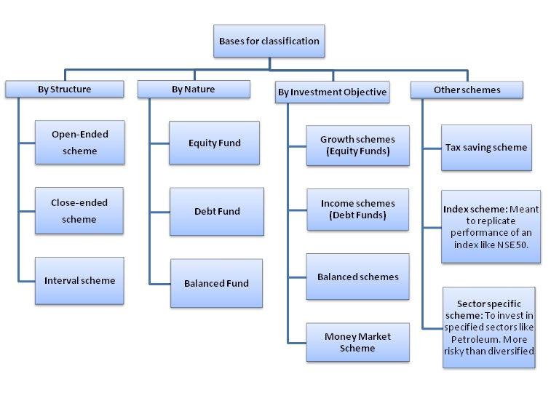

Slide 35
On the basis of Operation
Close ended funds: Under this type of fund, the size of the fund and its duration are fixed in advance. Once the subscription reaches the predetermined level, the entry of investors will be closed. After the expiry of the fixed period, the entire corpus is disinvested and the proceeds are distributed to the unit holders in proportion to their holding.
Features of Close ended Funds
(a) The period and the target amount of the fund is fixed beforehand.
(b) Once the period is over and/ or the target is reached, the subscription will be closed (i.e. investors cannot purchase any more units).
(c) The main objective is capital appreciation.
(d) At the time of redemption, the entire investment is liquidated and the proceeds are liquidated and the proceeds are distributed among the unit holders.
(e) Units are listed and traded in stock exchanges.
(f) Generally the prices of units are quoted at a discount of upto 40% below their net asset value.
2. Open-ended funds: This is the just reverse of close-ended funds. Under this scheme the size of the fund and / or the period of the fund is not fixed in advance. The investors are free to buy and sell any number of units at any point of time.
Features of Open-ended Funds
The investors are free to buy and sell units. There is no time limit.
These are not trade in stock exchanges.
Units can be sold at any time.
(d) The main motive income generation (dividend etc.) (e) The prices are linked to the net asset value because units are not listed on the stock exchange.

Slide 36
B. On the basis of return/ income
Income fund: This scheme aims at generating regular and periodical income to the members. Such funds are offered in two forms. The first scheme earns a target constant income at relatively low risk. The second scheme offers the maximum possible income.
Features of Income Funds
(a) The investors get a regular income at periodic intervals.
(b) The main objective is to declare dividend and not capital appreciation.
(c) The pattern of investment is oriented towards high and fixed income yielding securities like bonds, debentures etc.
(d) It is best suited to the old and retired people.
(e) It focuses on short run gains only.
2. Growth fund: Growth fund offers the advantage of capital appreciation. It means growth fund concentrates mainly on long run gains. It does not offers regular income. In short, growth funds aim at capital appreciation in the long run. Hence they have been described as “Nest Eggs” investments or long haul investments.
Features of Growth Funds
(a) It meets the investors’ need for capital appreciation.
(b) Funds are invested in equities with high growth potentials in order to get capital appreciation.
(c) It tries to get capital appreciation by taking much risk.
(d) It may declare dividend. But the main objective is capital appreciation.
(e) This is best suited to salaried and business people.

Slide 37
3. Conservative fund: This aims at providing a reasonable rate of return, protecting the value of the investment and getting capital appreciation. Hence the investment is made in growth oriented securities that are capable of appreciating in the long run.
C. On the basis of Investment
Equity fund: it mainly consists of equity based investments. It carried a high degree of risk. Such funds do well in periods of favourable capital market trends.
Bond fund: It mainly consists of fixed income securities like bonds, debentures etc. It concentrates mostly on income rather than capital gains. It carries lower risk. It offers secure and steady income. But there is no chance of capital appreciation.
Balanced fund: It has a mix of debt and equity in the portfolio of investments. It aims at distributing regular income as well as capital appreciation. This is achieved by balancing the investments between the high growth equity shares and also the fixed income earning securities.
Fund of fund scheme: In this case funds of one mutual fund are invested in the units of other mutual funds.
Taxation fund: This is basically a growth oriented fund. It offers tax rebates to the investors. It is suitable to salaried people.
Leverage fund: In this case the funds are invested from the amounts mobilized from small investors as well as money borrowed from capital market. Thus it gives the benefit of leverage to the mutual fund investors. The main aim is to increase the size of the value of portfolio. This occurs when the gains from the borrowed funds are more than the cost of the borrowed funds. The gains are distributed to unit holders.
Off shore mutual funds: The sources of investments for these funds are from abroad.

Slide 38
Stock broking :-
It is a service which gives retail and institutional investors the opportunity to buy and sell equities.
There are several different services a stockbroker can provide:
Execution-only stockbrokers will complete orders on customer behalf, but do not offer any advice
Advisory stockbrokers will offer advice on where to trade, but only trade on orders submitted by customers
Discretionary stockbrokers will trade on customers behalf, executing trades without their input
Share brokers in India are governed by the Securities and Exchange Board of India Act, 1992 and brokers must register with the Securities and Exchange Board of India. The National Stock Exchange of India and the Bombay Stock Exchange via brokers, provide an ecosystem to investors to trade in capital markets through various channels- broker offices, investment advisor or screen-based electronic trading system. An individual employed by an investment firm must complete the National Institute of Securities Markets (NISM) exam and apply to SEBI for registration as an Investment Advisor.
Stock market advisory and research services are highly regulated in India. Only SEBI registered stock advisory and investment research analysts are allowed to do so. The complete details of these authorized persons are available on website of SEBI for protection of investors.

Slide 39
What do stockbrokers do?
Stockbrokers serve as intermediaries between markets (e.g. exchanges) and the investing public. Brokers take order from customers and try to fill them at the best price possible. In return, they earn a fee known as a commission. Today, many stockbrokers have transitioned to financial advisors or planners as online brokerage platforms allow users to enter their own orders via the web or mobile app.
Educational Requirements for Stockbrokers
A bachelor's degree in finance or business administration is typically required for stockbrokers. A strong understanding of financial laws and regulations, accounting methods, principles of economics and currency, financial planning, and financial forecasting all are useful for working in the field.
Global credentials are also becoming increasingly sought-after as signals of legitimacy and financial acumen. Examples include the certified financial planner (CFP) and chartered financial analyst (CFA) designations.

Slide 40
Understanding the Role of a Stockbroker
Buying or selling stocks requires access to one of the major exchanges such as the New York Stock Exchange (NYSE) or the NASDAQ(National Association of Securities Dealers Automated Quotations). To trade on these exchanges broker must be a member of the exchange or belong to a member firm. Member firms and many of the individuals who work for them are licensed as brokers or broker-dealers by the Financial Industry Regulatory Authority (FINRA).
While it is possible for an individual investor to buy stock shares directly from the company that issues them, it is much simpler to work with a stockbroker.
Top stock brokers in India that are ruling the Indian share..
Zerodha.
Upstox.
India Infoline (IIFL)
Sharekhan
Angel Broking.

Slide 41
Credit rating:
Credit rating means giving an expert opinion by a rating agency on the relative willingness and ability of the issuer of a debt instrument to meet the financial obligations in time and in full. It measures the relative risk of an issuer’s ability and willingness to repay both interest and principal over the period of the rated instrument. It is a judgement about a firm’s financial and business prospects. In short, credit rating means assessing the creditworthiness of a company by an independent organization.
Different Kinds of Credit Rating are Listed Below
Different kinds of credit rating are listed below:
(1) Bond/debenture rating:
(2) Equity rating:
(3) Preference share rating:
(4) Commercial paper rating:
(5) Fixed deposits rating:
(6) Borrowers rating:
(7) Individuals rating:

Slide 42
Registration:
Credit Rating agencies are regulated by SEBI.
Registration with SEBI is mandatory for catting out the rating business.
A registration fee of Rs. 25000 should be paid to SEBI.
Some of the Top Credit Rating Agencies in India are:
Credit Rating Information Services of India Limited (CRISIL) ...
Information and Credit Rating Services Limited(ICRA)...
Credit Analysis and Research limited (CARE) ...
Brickwork Ratings (BWR) ...
India Rating and Research Pvt...
Small and Medium Enterprises Rating Agency of India (SMERA)
FITCH India…

Slide 43
Eligibility Criteria
First setup and registered as a company
Has specified rating activity as one of its main objects in its Memorandum of Association
Has a minimum Net worth of Rs. 5 crore.
Has adequate Infrastructure
Promoters have professional competence, financial soundness and a general reputation of fairness and integrity in business transactions, to the satisfaction of SEBI.
Has employed persons with adequate professional and other relevant experience, as per SEBI directions.
Promotor
A Credit rating agency can be promoted by:
Public Financial Institution
Scheduled bank
Foreign Bank operating in India with RBI approval
Foreign Credit Rating agency having at least five years experience in rating securities
Any company having a continuous net worth of minimum 100 cores for the previous five years.

Slide 44
Leasing:
Lease: Definition, Features, Advantages, Disadvantages, Types
A lease is a contract under which one party, the lessor (owner of the asset), gives another party (the lessee) the exclusive right to use the asset, usually for a specified time in return for the payment of rent.
Major Features of Lease
The major features or elements of the leasing are the following:
The Contract: There are essentially two parties to a contract of lease financing, namely the owner and the user.
Assets: The assets, property to be leased are the subject matter lease financing contract.
Lease Period: The basic lease period during which the lease is non-cancelable.
Rental Payments: The lessee pays to the lessor for the lease transaction is the lease rental.
Maintain: Provision for the payment of the costs of maintenance and repair, taxes, insurance, and other expenses appertaining to the asset leased.
Term of Lease: The term of the lease is the period for which the agreement of lease remains in operation.
Ownership: During the lease period, ownership of the assets is being kept with the lessor, and its use is allowed to the lessee.
Terminating: At the end of the period, the contract may be terminated.
Renew or Purchase: An option to renew the lease or to purchase the assets at the end of the basic period.
Default: The lessee may be liable for all future payments at once, receiving title to the asset in exchange.

Slide 45
Operating Lease: An operating lease is a cancelable contractual agreement whereby the lessee agrees to make periodic payments to the lessor, often for 5 or fewer years, to obtain an asset set’s services. According to the International Accounting Standards (IAS-17), an operating lease is one that is not a finance lease.
Financial Lease: A financial (or capital) lease is a longer-term lease than an operating lease that is non-cancelable and obligates the lessee to make payments for the use of an asset over a predetermined .period of time. According to the International Accounting Standard (IAS-17), in a financial lease, the lessor transfer to the lessee substantially all the risks and rewards identical to the ownerships of the asset whether or not the title is eventually transferred.
Direct Lease: Under direct leasing, a firm acquires the right to use an asset from the manufacture directly. The ownership of the asset leased out remains with the manufacture itself.
Sale & Leaseback: Under the sale & leaseback arrangement, the firm sells an asset that it owns and then leases to the same asset back from the buyer. This way, the lessee gets the assets for use, and at the same time, it gets cash.
Leveraged Lease: Leveraged lease is the same as the direct lease, except that a third party, the lender, is involved in addition to the lessee & lessor. The lender partly finances the purchase of the asset to be leased; the lessor turns to be a borrower.

Slide 46
Advantages of Lease Financing
The advantages from the viewpoint of the lessee
Saving of Capital: Leasing covers the full cost of the equipment used in the business by providing 100% finance. The lessee is not to provide or pay any margin money as there is no down payment. In this way, the saving in capital or financial resources can be used for other productive purposes, e.g., the purchase of inventories.
Flexibility and Convenience: The lease agreement can be tailor-made in respect of lease period and lease rentals according to the convenience and requirements of all lessees.
Planning Cash Flows: Leasing enables the lessee to plan its cash flows properly. The rentals can be paid out of the cash coming into the business from the use of the same assets.
Improvement in Liquidity: Leasing enables the lessee to improve its liquidity position by adopting the sale and leaseback technique.
Shifting of Risk of Obsolescence: The lessee can shift the risk upon the lessor by acquiring the use of assets rather than buying the asset.
Maintenance And Specialized Services: In the case of a special kind of lease arrangement, the lessee can avail specialized services of the lessor for maintenance of asset leased. Although lesser charges higher rentals for providing such services, leases see overall administrative and service costs are reduced because of specialized services of the lessor.
Off-the-Balance-Sheet-Financing: Leasing provides “off-balance-sheet” financing for the lessee in that the lease is recorded neither as an asset nor as a liability.

Slide 47
The advantages from the viewpoint of the lessor
There are several extolled advantages of acquiring capital assets on lease:
Higher profits: The Lessor can get higher profits by leasing the asset.
Tax Benefits: The Lessor being the owner of an asset, can claim various tax benefits such as depreciation.
Quick Returns: By leasing the asset, the lessor can get quick returns than investing in other projects of the long gestation period.
Disadvantages of Lease Financing
The disadvantages from the viewpoint lessee
Higher Cost: The lease rental includes a margin for the lessor as also the cost of risk of obsolescence; it is, thus, regarded as a form of financing at a higher cost.
Risk: Risk of being deprived of the use of assets in case the leasing company winds up.
No Alteration in Asset: Lessee cannot make changes in assets as per his requirement.
Penalties On Termination of Lease: The lessee has to pay penalties in case he has to terminate the lease before the expiry lease period.
The disadvantages from the viewpoint of lessor
High Risk of Obsolescence: The Lessor has to bear the risk of obsolescence as there are rapid technological changes.
Price Level Changes: In the case of inflation, the prices of an asset rise, but the lease rentals remain fixed.
Long term Investment: Leasing requires the long term investment in the purchase of an asset and takes a long time to cover the cost of that asset

Slide 48
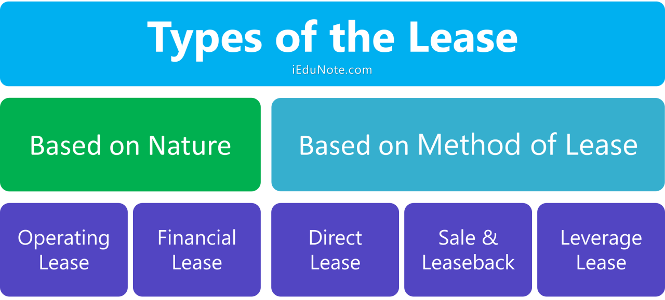

Slide 49
Presented By:
Vaishali Chauhan
(Malla Reddy University, Hyderabad)
Thank You…

